Slide 1

Recipe to Sale Price Data
Michelle Rogers

Slide 2
Data Exploration
The data is retrieved in JSON format from the Spoonacular API. The data contains fields that would allow the recipes to be searched by categories like vegan, gluten-free, cheap, etc.
For this project, the most important piece of the data is found in the extendedIngredients column(which converted to a Pandas dataframe). This extendedIngredients contains a field that is the name of the ingredient. This field can be matched to the data in sale flyers from grocery stores.
Each time new data is retrieved from the API, it is concatenated to the existing dataframe and saved into a file with duplicates removed.
Two unnecessary columns were removed from the dataframe that were regarding and old id and the price for the recipe, which was not clear how it was calculated. This will be done in comparison with sale flyers.

Slide 3
Data Storage
The data will be stored in a MySQL database.
MySQL is relational and this data does fit a relational model.
If I continue to add recipes to the data, MySQL has good scalability, both horizontally and vertically. If necessary, it also allows for dividing the data into smaller chunks through partitioning. It is easily supported by many data analysis tools and platforms. It is cost effective, since it is open source and free.
Some of its limitations are storing unstructured data; however the "images" in this data are not actually storing images, but rather the URL to the images. MySQL also might not be able to handle high-velocity data streams, but in this case, a high-velocity data stream would require payment to Spoonacular, anyway, and that is not the current plan.

Slide 4
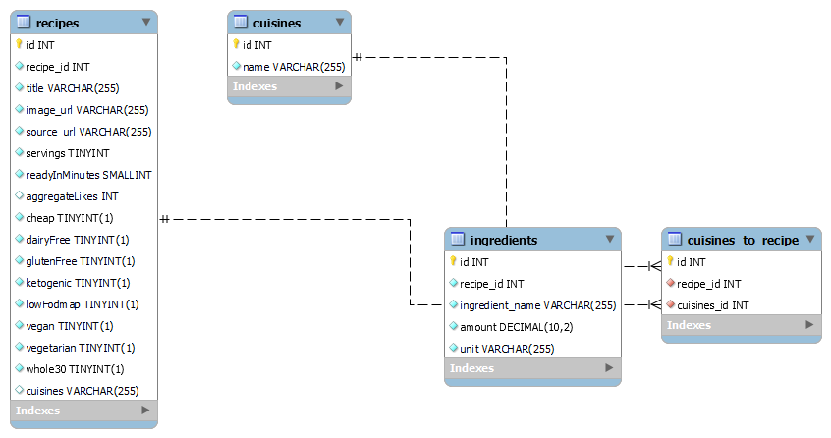
Entity Relationship Model

